Slide 1
India’s Rich Culture Website

Slide 2
Introduction
Greetings Everyone!
My name is Tejeshwi Anand Jha and I am in sixth standard.I live in Guwahati Assam.
So the theme I have chosen is the first theme in which we have to make a website on India’s rich culture. I have made a Home,About and Contact and six pages for writing India’s rich culture.

Slide 3
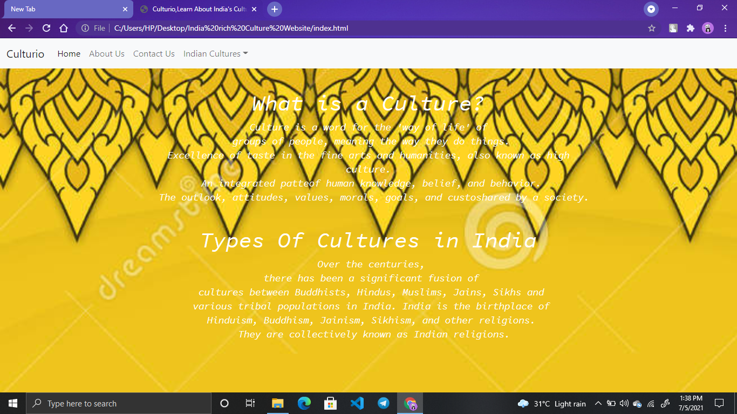
Home Page

Slide 4
About my Home page
As you seen the home I have given the basic definition of culture and many types of culture in India. I have made the header with bootstrap and done the other things myself.

Slide 5
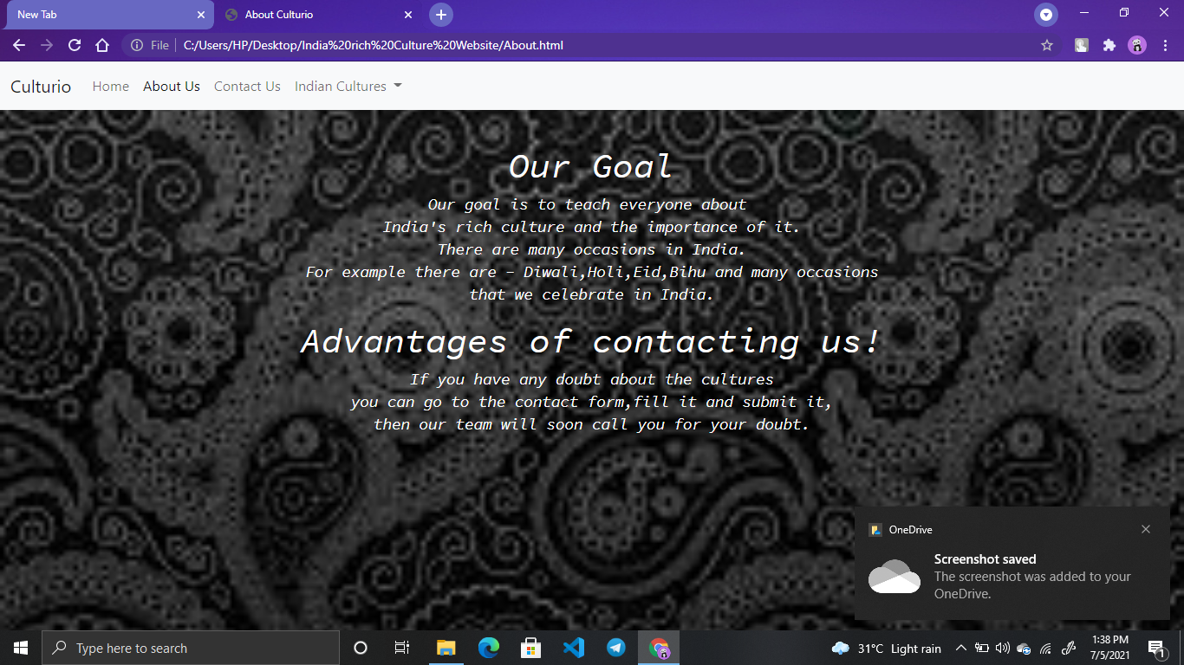
About Page

Slide 6
About the About page
As you seen the photo of the About page I have given our goals and advantages of contacting us.

Slide 7
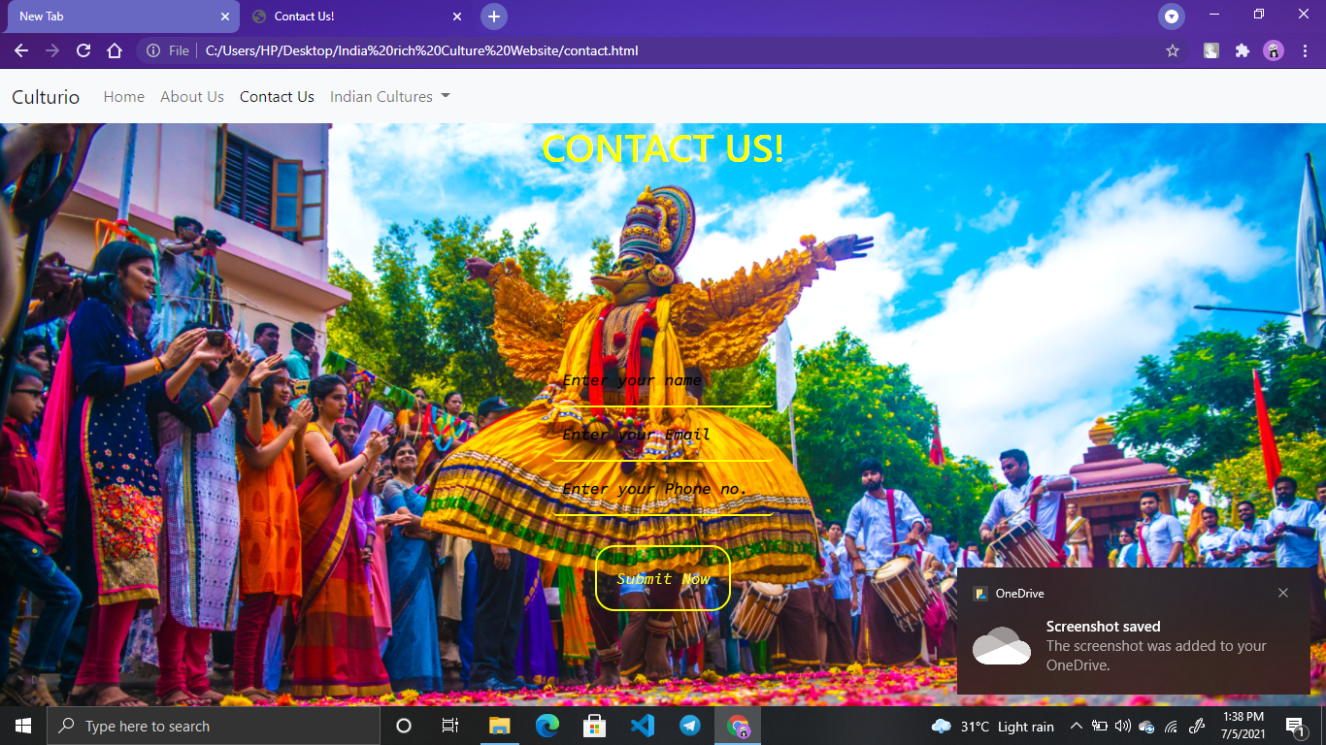
Contact page

Slide 8
About the contact page
As you have seen the photo of contact page I have made a form and done the background none for the input and when we click the submit button we will get a alert that our form is submitted.

Slide 9
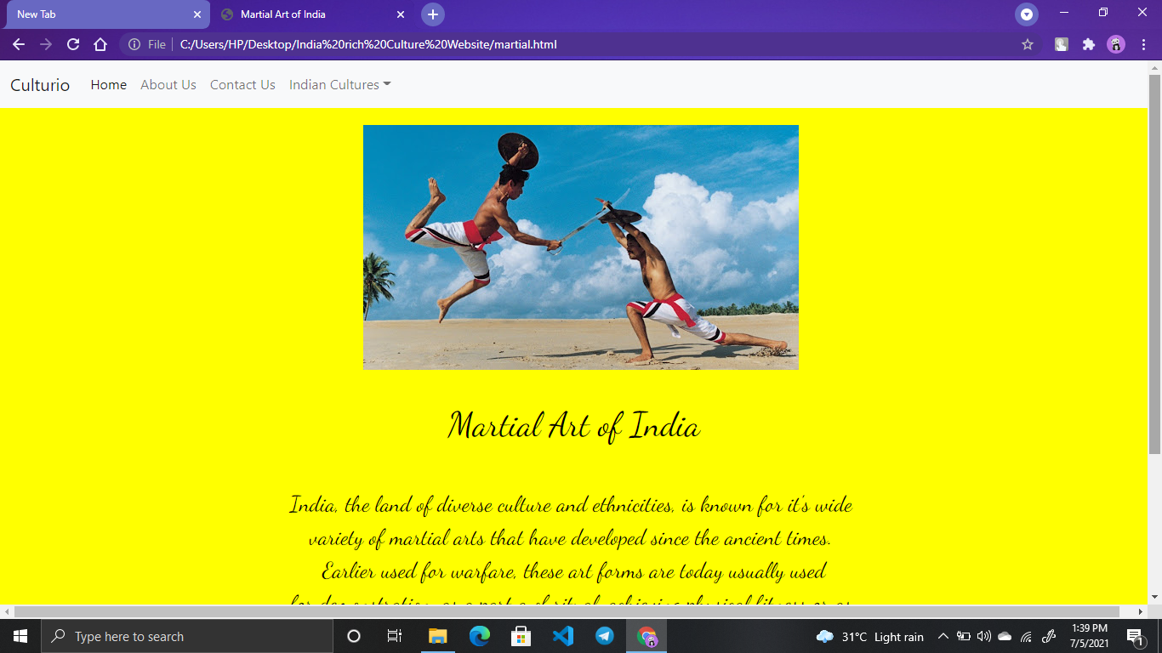
One of my rich culture page

Slide 10
About one of the rich culture page
As you have seen the photo I have given a photo in the page and written few lines about it. And I have done the background yellow. And I have done the same to all the rich culture pages.

Slide 11
Thank you for seeing my presentation.

